Slide 1
SCC211 Operation System
(User Spaces)
Zhang Jinyu – zjy@bjtu.edu.cn
School of Computer and Information Technology
SD408

Slide 2
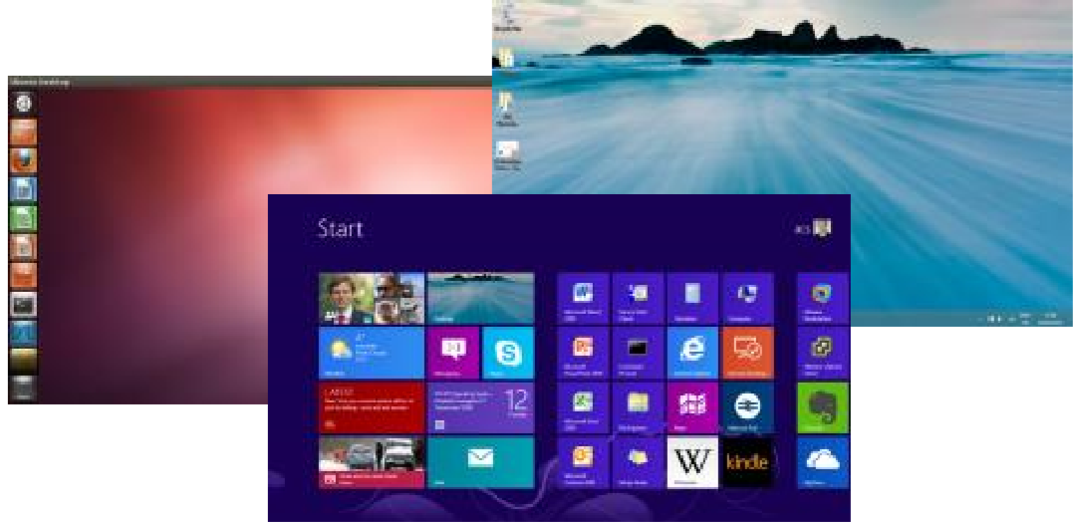
Graphical User Interface/ Desktop
Typically a normal user processes
Windows more optimized/ integrated than most
Compromises design
兼容

Slide 3
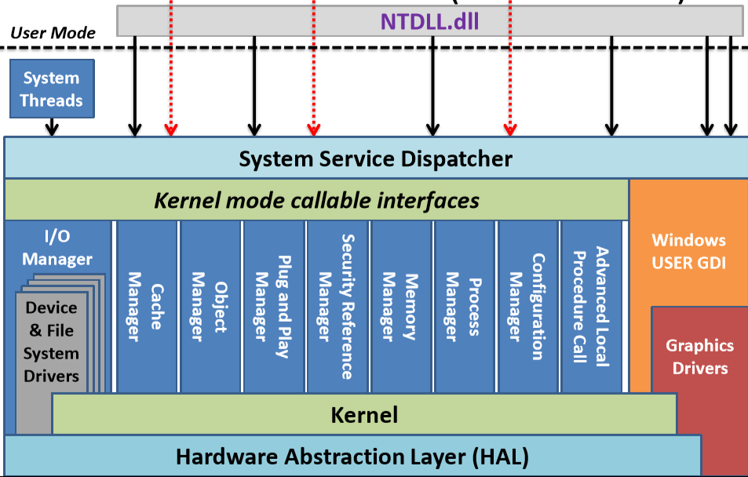
Windows Architecture (Kernel Mode)
NT：块大

Slide 4
OS Personality
User interface not always good indicator of kernel features
e.g. NT designed to have/ support multiple personalities
Windows
Unix/ POSIX (Portable Operating System Interface)
OS/2
Simplified by initial Micro-Kernel type design
Personality differences can become visible (in odd ways!)
e.g. Unix file-system features make little sense in Windows Desktop

Slide 5
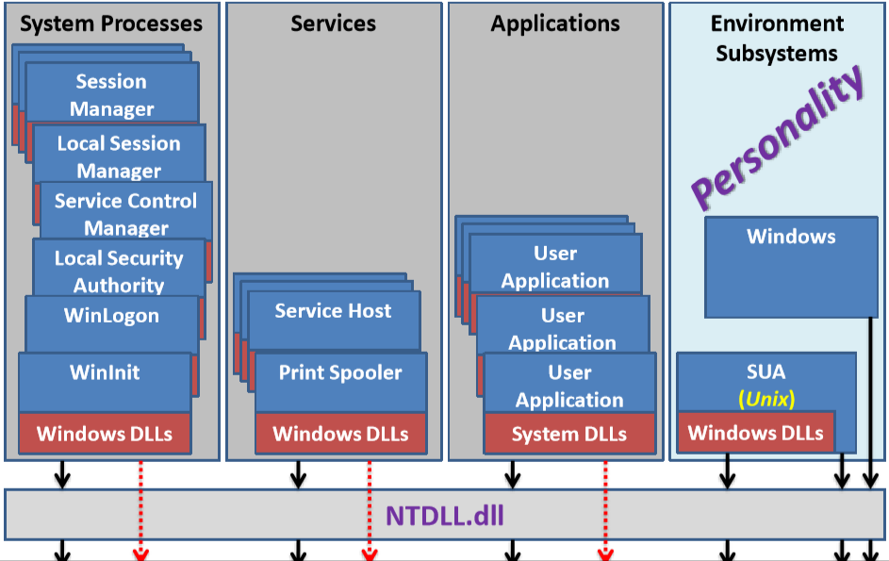
Windows Architecture (User Mode)

Slide 6
Changing capabilities (Permissions)
权限
Replace with those of another user or group
Raise or lower permissions
su (set/ substitute user) command and setuid/ seteuid/ setgid/ setegid functions
Cause explicit change to User ID or Group ID
Give different access rights than user would normally have
setuid/ setgid bit on executable program files
Similar to above but IDs changed when program run

Slide 7
Accessing System Resources
How can following work and be controlled?
Keep two sets of IDs
Current (normal) User ID and Group ID
Effective User ID (uid) and Effective Group ID (gid)
But these are for ‘long-lived’ operations
For lifetime of process or terminal session
What about short-term operations
e.g. Need access to a device for input and output?

Slide 8
Accessing System Resources
System calls
open( ), read( ), write( ), close( ), exit( ), …
Modern systems have around 300 such calls
Each has
Stub function (in user space) compiled into user code
e.g. provided by standard C library: libc, newlib, …
Corresponding kernel function to perform operation
Need mechanism to link the two…
Also, need generic mechanisms to switch between privilege levels

Slide 9
CHANGING PRIVILEGE LEVELS

Slide 10
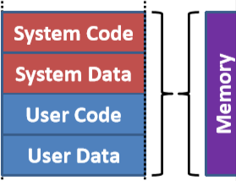
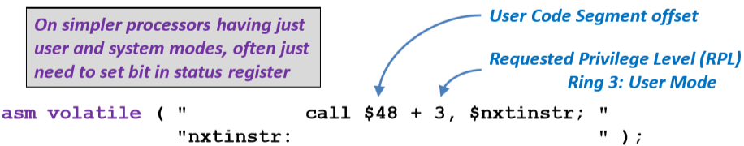
Entering User Mode on x86
Entering User Mode on x86
At end of kernel initialization, simply
Do a call to code in User Code Segment
Remember we set all segments to all memory
Set Requested Privilege Level (RPL) to Ring 3 (User Mode)
We can always reduce our privilege level, but not increase it
Next instruction will have only user privilages

Slide 11
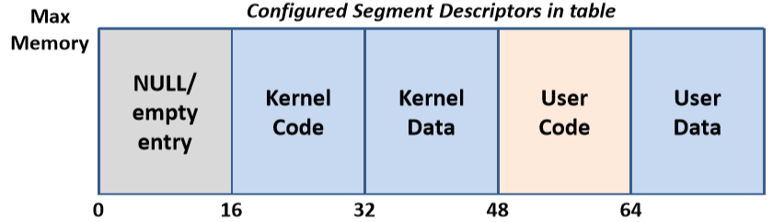
Recall: Common Configuration
Now rarely (actively) use segmentation
Offers more flexible protection (even to object level)
Difficult to share memory (code or data)
Unlike paging it’s visible to code/ programmer
Typically configure system to rely ‘solely’ on paging
All segments span full memory range, as in common x86 set up:

Slide 12
From User Mode to System Mode
Need mechanism to move from Ring 3 to Ring 0
User processes often need access to system resources
Can’t wait for
Next scheduling cycle
Process to do I/O
Only mechanism we’ve seen is interrupts
But these have always been hardware events…

Slide 13
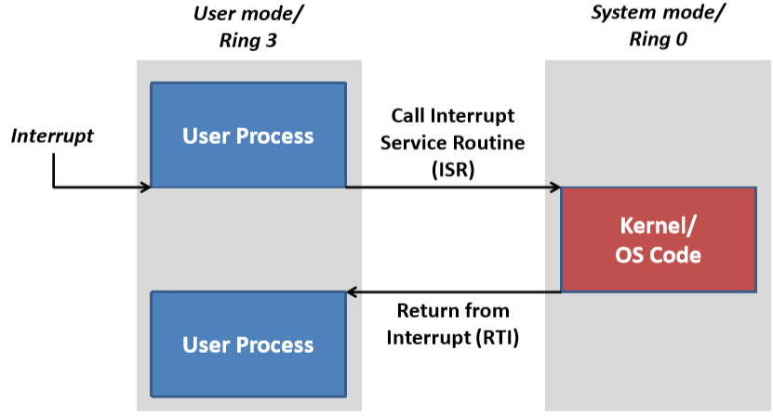
Interrupts and Privilege Level

Slide 14
Software Interrupts and Traps
主动上报
Most processors allow user code to raise an interrupt
Effectively generating a virtual exception
Handled as a normal (hardware) interrupt
Jumps via interrupt vectors to Interrupt Service Routine
Allows a change from User mode to System mode
Safe as just a simple ‘event’
Typically provided as INT, TRAP, SYSCALL instruction
软件发出

Slide 15
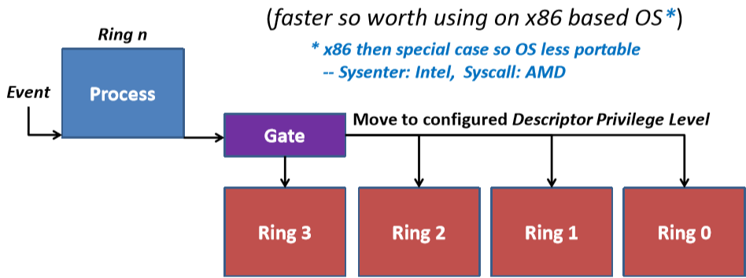
Multiple Rings: x86 Interrupt Gates
‘Gate’ tied to each Interrupt Descriptor/ Vector
A similar Call Gate mechanism also exists on x86
These are less portable and not widely used
‘Replaced’ by simpler Sysenter/ Sysexit + Syscall/ Sysret

Slide 16
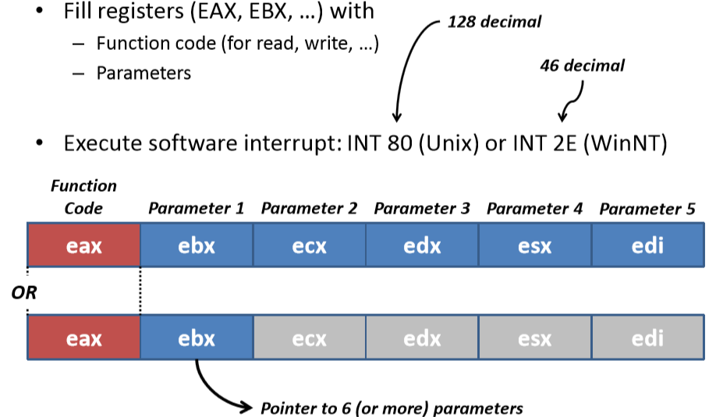
Making a system call on x86
系统调用是操作系统提供给用户程序使用的一组接口，用户程序可以通过系统调用请求操作系统执行一些特权操作，如创建、读写文件、网络通信、进程管理、内存管理等。

Slide 17
Simple I/O Example
int main ( ) {
char * msg = "Hello World\n";
int fd = 1; // stdout: normal output stream
int len = (int) strlen(msg);
int retval;
retval = write(fd, msg, len); // Needs kernel privileges!!!
printf ("write(fd, msg, len) reported %d characters written\n", retval);
}

Slide 18
Making Unix System Calls
# Build with: as syscall.s -o syscall.o
# ld syscall.o -o syscall
.section .rodata MSG: .string "Hello World\n“
.set LEN, .-MSG # calculate length of message string
.text
.global _start
_start:
mov $4, %eax # write: System call #4
mov $1, %ebx # fd = 1 : stdout
mov $MSG, %ecx # msg : char * msg
mov $LEN, %edx # number of characters to output
int $0x80 # syscall: int write(fd, msg, len)
mov $1, %eax # exit: System call #1
mov $0, %ebx # code = 0 (success)
int $0x80 # syscall: exit(0)

Slide 19
Direct System Call from C
int main ( ) {
char * msg = "Hello World\n";
int fd = 1; // stdout
int len = (int) strlen(msg);
int retval;
asm volatile (
"mov $4, %%eax; # write: System call #4"
"int $0x80; # syscall: int write(fd, msg, len)"
"movl %%eax, %0 # get return value from function"
: "=rm" (retval) // %0 refers to return variable retval
: "b" (fd), "c" (msg), "d" (len) // Place in EBX, ECX, EDX
: "%eax" // Clobbered/ overwritten
);
printf ("write(fd, msg, len) reported %d characters written\n", retval);
}
Remember inline assembler allows us to directly specify the x86 registers variables should be passed in, e.g., to pass fd in reg. EBX we use “b” (fd) -- this really simplifies the code

Slide 20
System Call Entry Point
入口点
Software Interrupts appear as any other interrupt
Normal ISR entry point
Simply check for Unix (0x80) or NT (0x2E) ‘call’ convention
void interrupt_handler(
struct cpu_registers regs, uint32_t irq, uint32_t code,
uint32_t eip, uint32_t cs, uint32_t flags,
uint32_t esp, uint32_t ss ) {
switch (irq) {
case 0x80: // INT 0x80 (80 hex = 128 decimal)
systemcall ( &regs );
break;

Slide 21
Unix System Calls
struct sysmap {
void * fn; // Function pointer to handler function
char * name; // Name for debug/ call-trace };
struct sysmap syscalls [ ] = {
/* 0 */ { NULL, "NULL" },
/* 1 */ { sys_exit, "sys_exit" },
/* 2 */ { sys_fork, "sys_fork" },
/* 3 */ { sys_read, "sys_read" },
/* 4 */ { sys_write, "sys_write" },
/* 5 */ { sys_open, "sys_open" },
/* 6 */ { sys_close, "sys_close" },
/* 7 */ { sys_waitpid,"sys_waitpid" },
/* 8 */ { sys_creat, "sys_creat" },
/* 9 */ { sys_link, "sys_link" },
/* 10 */ { sys_unlink, "sys_unlink" },
/* 11 */ { sys_execve, "sys_execve" },
/* 12 */ { sys_chdir, "sys_chdir" }, // etc.
系统提供的

Slide 22
System Call Dispatcher
void systemcall ( struct cpu_registers * regs ) {
if ( regs->eax > MAX_SYSCALL || syscalls[ regs->eax ].fn == NULL ) {
printk ("No handler for syscall %ud\n", regs->eax);}
else { /*Entries in array are pointers to functions returning // type uint32_t: call function referenced by EAX value */
regs->eax = ( (uint32_t (*)( ) )
syscalls[ regs->eax ].fn)(
regs->ebx,
regs->ecx, regs->edx,
regs->esx, regs->edi );
}

Slide 23
CREATING PROCESSES

Slide 24
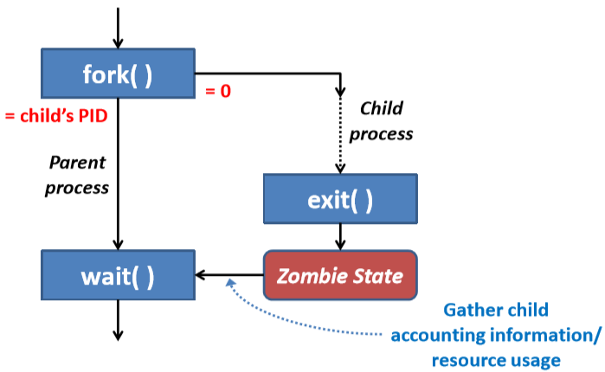
Creating a Process
In Unix this carried out by fork( ) system call
Returns child’s Process ID to parent and 0 to child

Slide 25
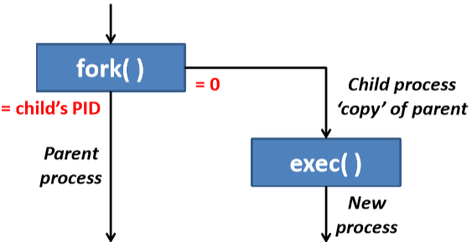
Running a New Application
Fork( ) creates duplicate copy of parent
Often immediately run exec( ) to start new application
Replaces all of child’s pages with those for application
Doesn’t make sense to copy all parent’s memory
Only to immediately replace it with new application code + data

Slide 26
Copy on write
Duplicate parent’s page tables
Parent and child have identical tree of tables
Both sets of tables reference same memory pages
Child shares all parent’s pages
Mark all pages as Read-Only in child and parent
But need to remember which should be writeable
Only works until one process needs to write
As pages Read-Only, any write will cause a page fault …we then copy page and re-run failed memory access

Slide 27
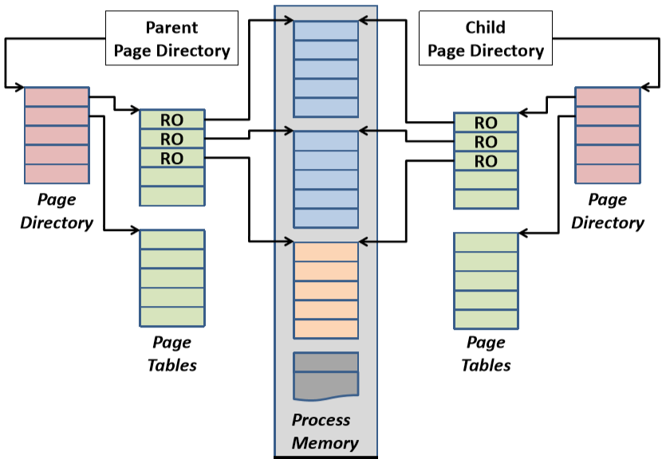
Creating a Child: Copy on Write

Slide 28
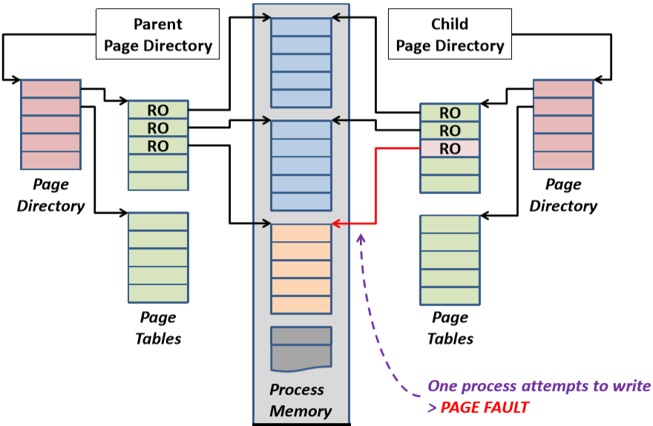
Creating a Child: Copy on Write

Slide 29
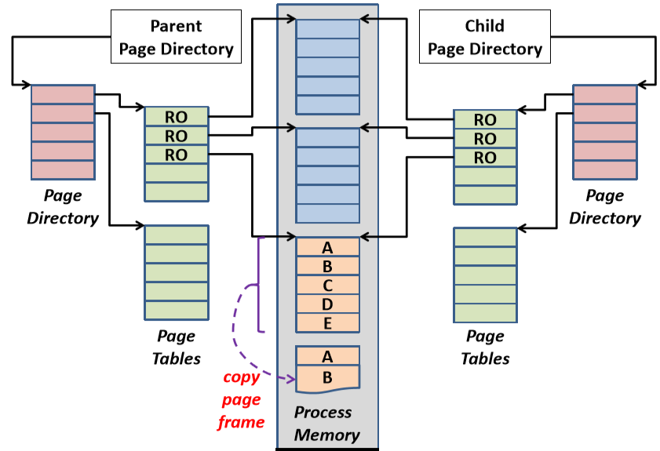
Creating a Child: Copy on Write

Slide 30
Creating a Child: Copy on Write

Slide 31
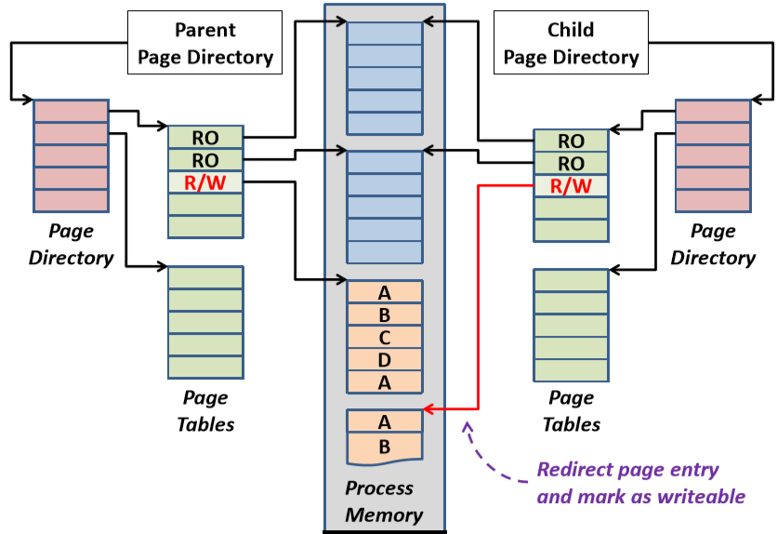
Creating a Child: Copy on Write

Slide 32
Adjacent Faulting
On page fault, often copy adjacent pages
Assume process will access them soon
Can tune to match available memory
With limited memory
Copy only faulted page
With lots of memory
Copy adjacent pages …e.g. WinNT copies up to 7 pages

Slide 33
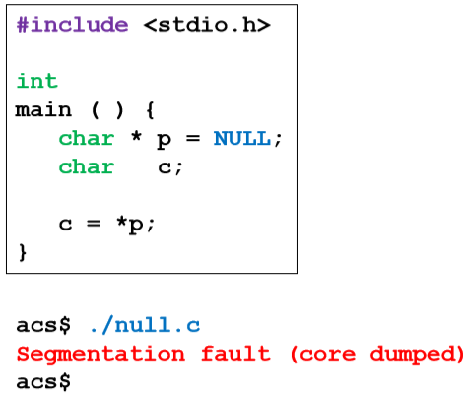
Catching NULL pointer references
Very common coding error
Using an un-initialized pointer

Slide 34
A NULL reference hits Page 0
Processes often have NULL/ no entry for Page 0
Causes page fault for any reference to Page 0
Catches any attempted access to address 0 (NULL)
For any apparent attempt to dereference NULL pointer
Send SIGSEGV to process
Segmentation Fault, Core Dumped

Slide 35
SHARED MEMORY

Slide 36
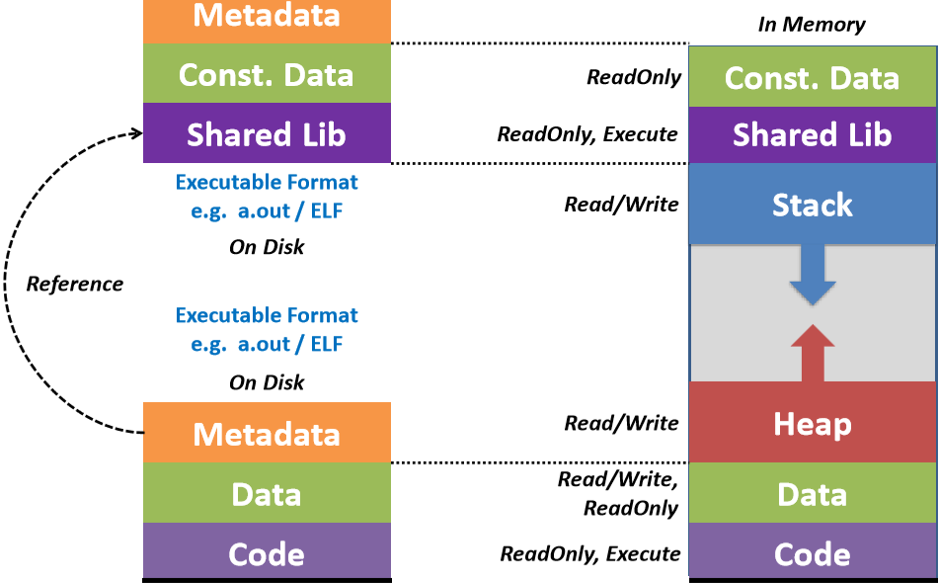
Processes and Shared Libraries

Slide 37
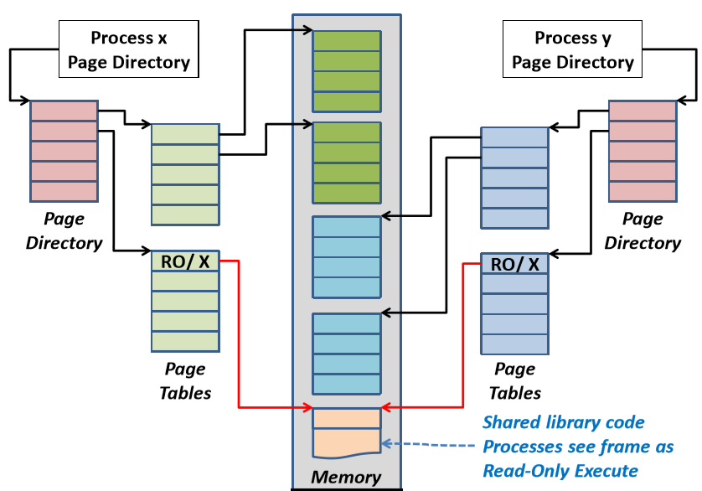
Shared Libraries (/Memory)

Slide 38
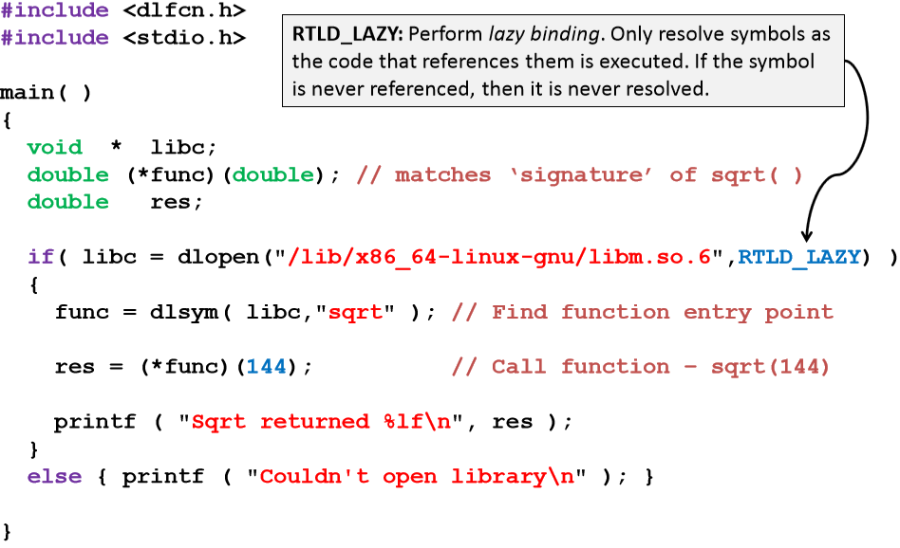
Dynamic Libraries

Slide 39
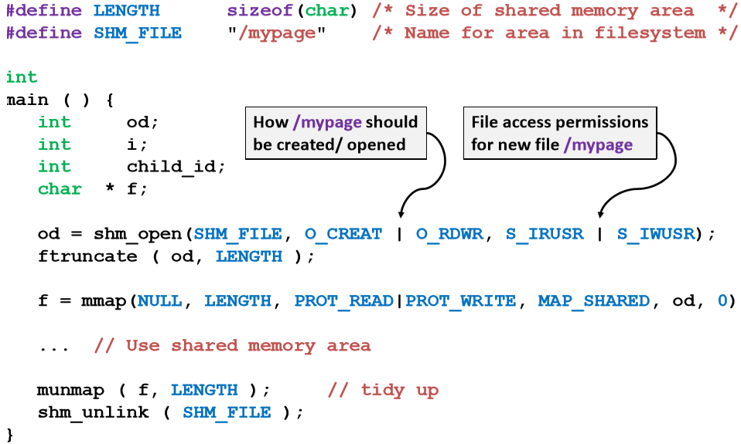
Creating a shared memory area

Slide 40
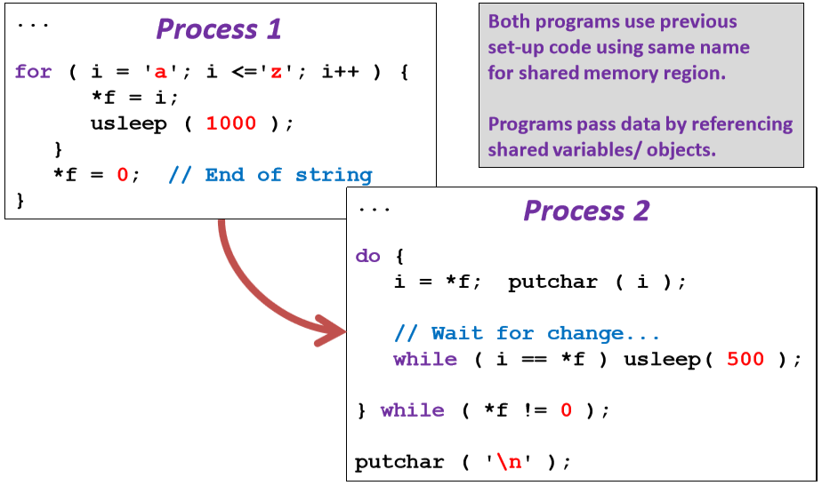
Example: using shared char * f

Slide 41
Memory Mapping a File
#define LENGTH 4096
int main ( ) {
int fd; int i; char * f;
if ( (fd = open ("testfile.txt", O_RDWR, 0)) < 0 ) exit (1);
f = mmap( NULL, LENGTH, PROT_READ | PROT_WRITE, MAP_FILE | MAP_SHARED, fd, 0 );
for (i = 0; i < 16; i++) f[i + 16] = f[i]; // Changes to memory reflected in file
munmap (f, LENGTH); close (fd);
}
对齐

Slide 42
Question？

